Slide 1


Credit Card Portfolio Analysis: A Strategic Overview
Driving business growth through data-driven customer insights.
Presented by: Ruchir Agrawal
Notes:
Hello, today, I’m excited to walk you through our latest Credit Card Analysis project. As markets become more competitive, understanding 'who' our customers are and 'how' they spend is no longer optional—it's a necessity. I'll demonstrate how we've turned raw transaction data into a strategic tool that identifies growth opportunities and improves customer retention.

Slide 2
Defining the Mission
Dashboard 1: Deep-dive into Customer Demographics and behavior.
Dashboard 2: Real-time Transaction monitoring and spending patterns.
Key Focus: Gender-based performance, income-level spending, and weekly revenue trends.
Notes:
Our goal was clear: Build two distinct but connected dashboards. The first focuses on the 'Customer'—their age, income, and education. The second focuses on the 'Transaction'—the velocity of spending and the methods used. By the end of this presentation, you’ll see how these two views work together to provide a 360-degree view of our portfolio.

Slide 3
The Foundation: Data & Purpose
Customer Data: 10k+ records (Age, Gender, Job, Income).
Transaction Data: Real-time logs (Amount, Category, Chip vs. Swipe).
The Why: To identify high-value segments and optimize marketing spend based on actual usage.
Notes:
We processed over 10,000 customer records and thousands of transactions. Why? Because looking at a bank statement isn't enough. We need to know if our 'Gold' cardholders are spending more on travel or groceries, and if our 'Silver' cardholders in Texas are more profitable than those in New York. This analysis bridge the gap between 'having data' and 'understanding profit'.

Slide 4
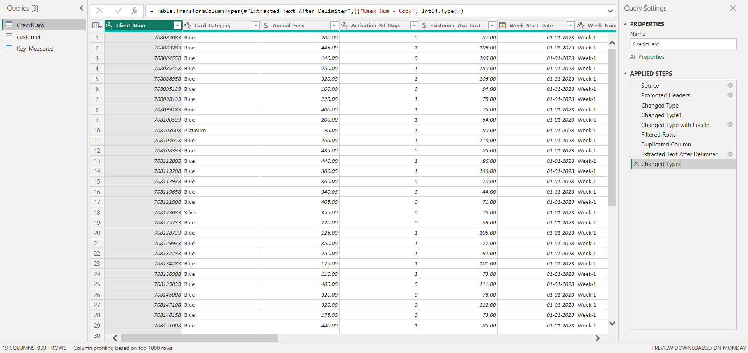
Engineering the Data Pipeline
Power Query: Standardized dates and removed nulls.
Relationship: One-to-Many link via Client_Num.
Optimization: Transformed text-based 'Week-1' strings into numeric values for time-series logic.
Notes:
Before the visuals, we did the heavy lifting in the back end. We used Power Query to clean inconsistencies and, most importantly, we built a robust Data Model. By linking customers to their transactions via their Client ID, we ensured that a single click on a 'Male' or 'Female' filter updates every single chart across the entire report instantly. We also converted text-based week numbers into actual integers to allow for mathematical growth calculations.

Slide 5
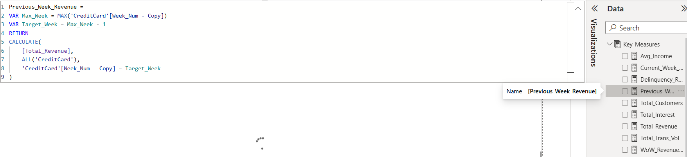
The Brain of the Report: DAX Measures
Categorization: Custom groups for Age and Income.
Time Intelligence: Current vs. Previous week revenue logic.
KPIs: Automated calculations for WoW (Week-on-Week) growth.
Notes:
We didn't just sum up columns; we built intelligence. Using DAX, we created dynamic 'buckets' for age and income so stakeholders can see high-level trends. We also developed 'Time Intelligence' measures that automatically compare this week’s revenue to last week’s. This allows us to see immediately if our revenue is growing or shrinking without manual calculation.

Slide 6
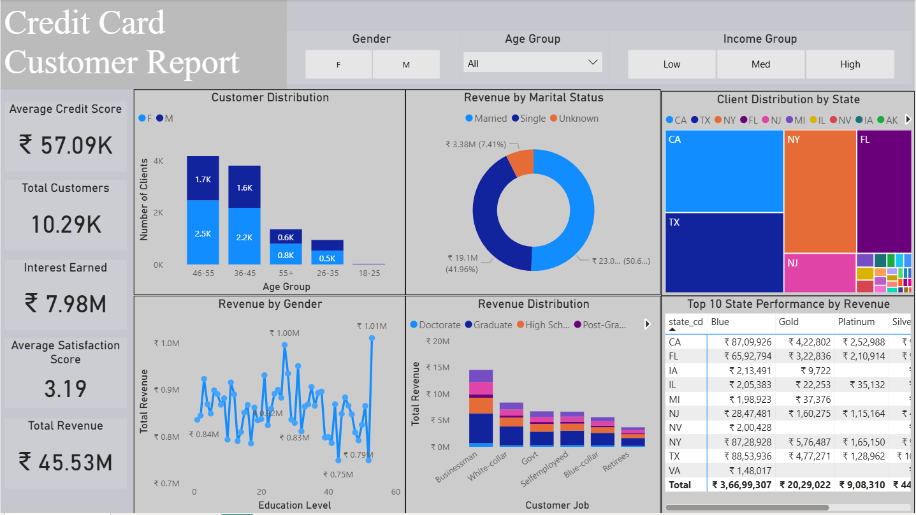
Dashboard 1: Customer Demographics
Interactive KPI Cards (Total Revenue, Customers, Interest).
Demographic breakdowns (Education, Marital Status, Job).
Geographic distribution by State.
Notes:
Welcome to the Customer Report. This is where we see the human side of the data. At a glance, you can see our Total Revenue and Average Satisfaction scores. The layout is designed to be 'Slicer-First'—meaning you set your parameters at the top, and the entire story below changes to match your selection.

Slide 7
Dashboard 1 Deep-Dive
Focus: Note how high-income earners have an annual income of > $70,000.
Notes:
Let’s look at the heavy hitters: the High-Income Group. By selecting this filter, we instantly see a shift in the portfolio's DNA. These aren't just our highest spenders; they are our most sophisticated users. The Education Level chart will likely show a concentration in "Graduate" and "Post-Graduate" levels.

Slide 8
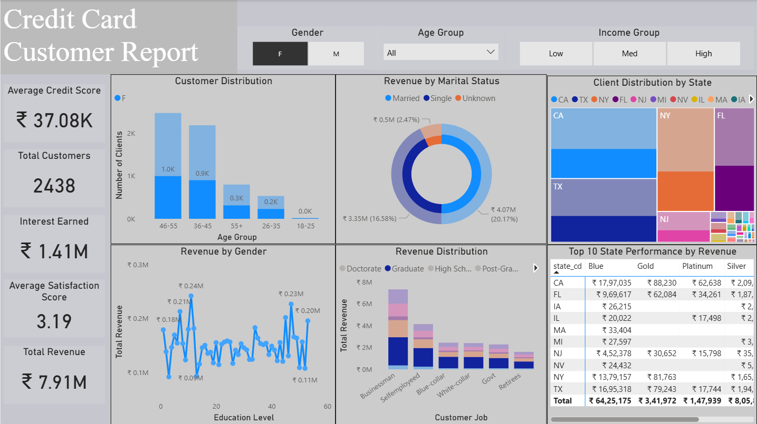
Dashboard 1 Deep-Dive
Focus: Female customers with a Graduate-level education. This group represents a high-retention, low-risk segment.
Notes:
Moving to our next deep-dive, let's look at the Graduate Female segment. Notice the 'Revenue by Job Type' visual on your screen. This demographic is largely composed of professionals in government and business roles. What does this mean for us? It means recurring, predictable revenue. Unlike higher-risk segments, these customers use their cards for consistent lifestyle needs. For the marketing team, the insight here is clear: this group doesn't need 'flashy' promotions; they value reliability and rewards that complement their professional lives.

Slide 9
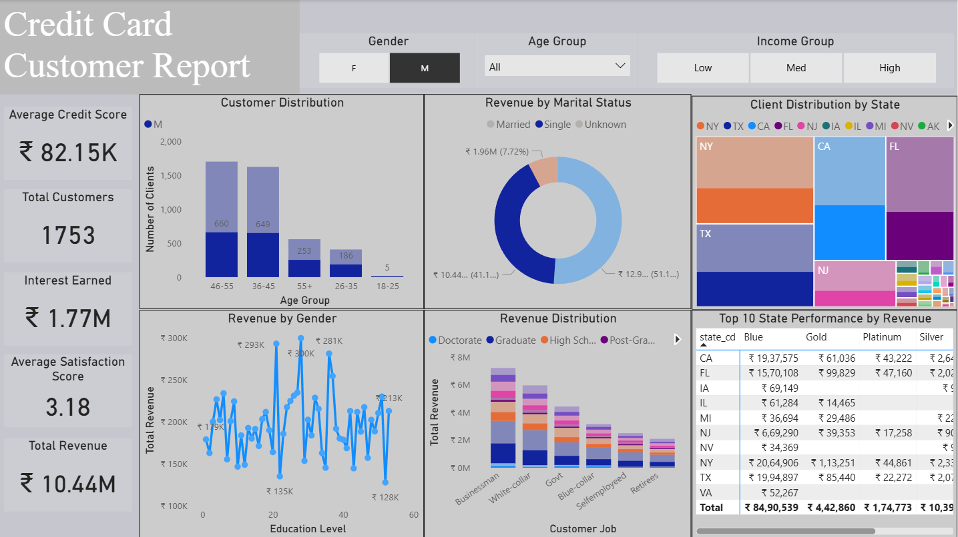
Dashboard 1 Deep-Dive
Focus: Male customers with 'Single' marital status. Represents the largest segment of 'Blue' cardholders—prime for 'Silver' tier upgrades based on credit score.
Notes:
Finally, let’s look at our most active lifestyle segment: the Single Male. When we filter for this group, the data tells a story of high velocity. Unlike our previous segments, these customers are spending heavily on 'Fuel' and 'Entertainment.' They are highly mobile and active consumers. What’s interesting here is that while they currently dominate our 'Blue' card category, many have the credit utilization ratios that suggest they are ready for a 'Silver' or 'Gold' upgrade.

Slide 10
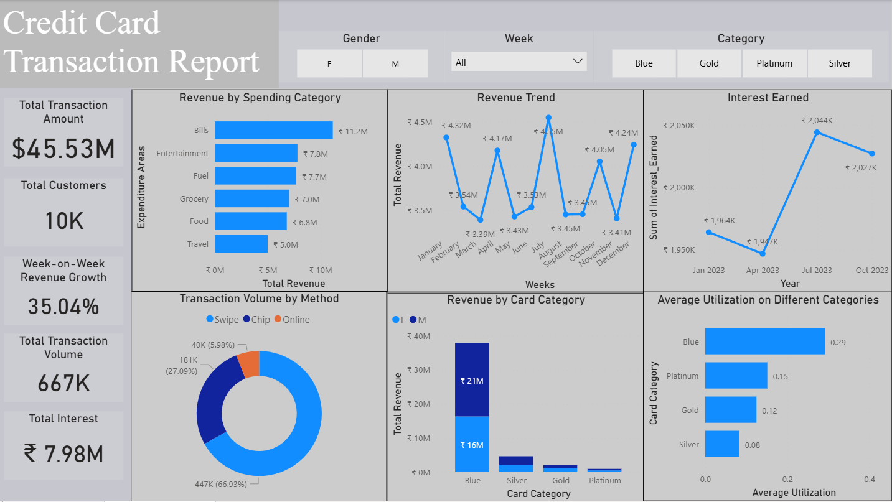
Dashboard 2: Transaction Insights
Spending by Category (Exp Type).
Weekly Revenue Trends.
Transaction Methods (Chip, Swipe, Online).
Notes:
Now, let's switch gears to the Transaction Report. If the first dashboard told us 'Who' they are, this one tells us 'What' they are doing. This is a high-velocity report designed to track spending habits and method preferences in real-time.

Slide 11
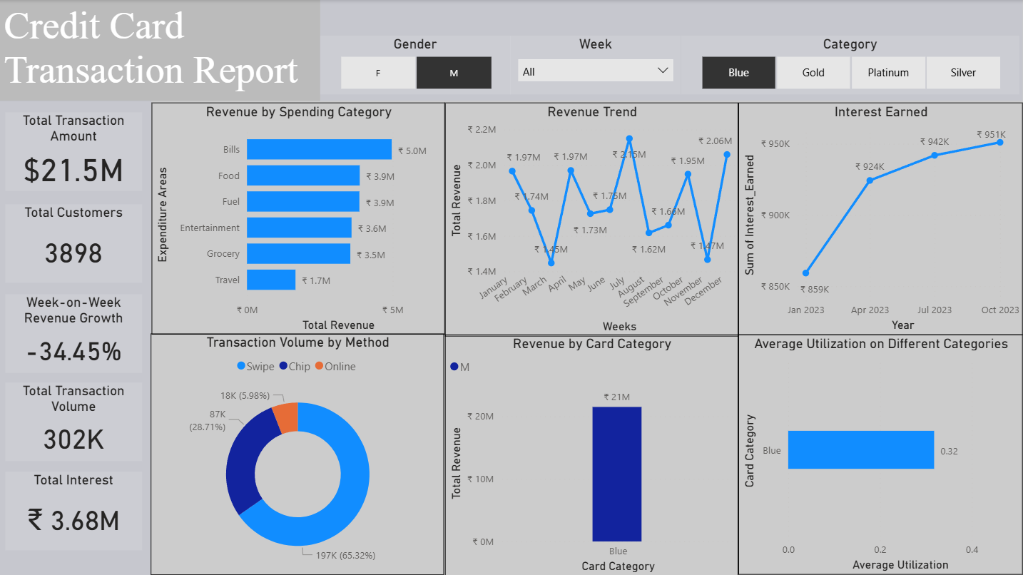
Dashboard 2 Deep-Dive
Focus: Male customers using the 'Blue' (Standard) Card category. Dominance in essential spending - Bills, Fuel, and Grocery.
Notes:
Let’s shift our focus to the engine room of our transaction volume: Males with Blue Cards. While our previous slides looked at high-income luxury spending, this filter shows us the daily reality of our portfolio.
Notice the spending categories here. We see a heavy concentration in 'Bills' and 'Fuel.' These are non-discretionary, recurring transactions. For the bank, this means consistent, predictable cash flow. Interestingly, this segment shows a high preference for 'Swipe' and 'Chip' transactions, suggesting they are using the card primarily in physical retail environments.

Slide 12
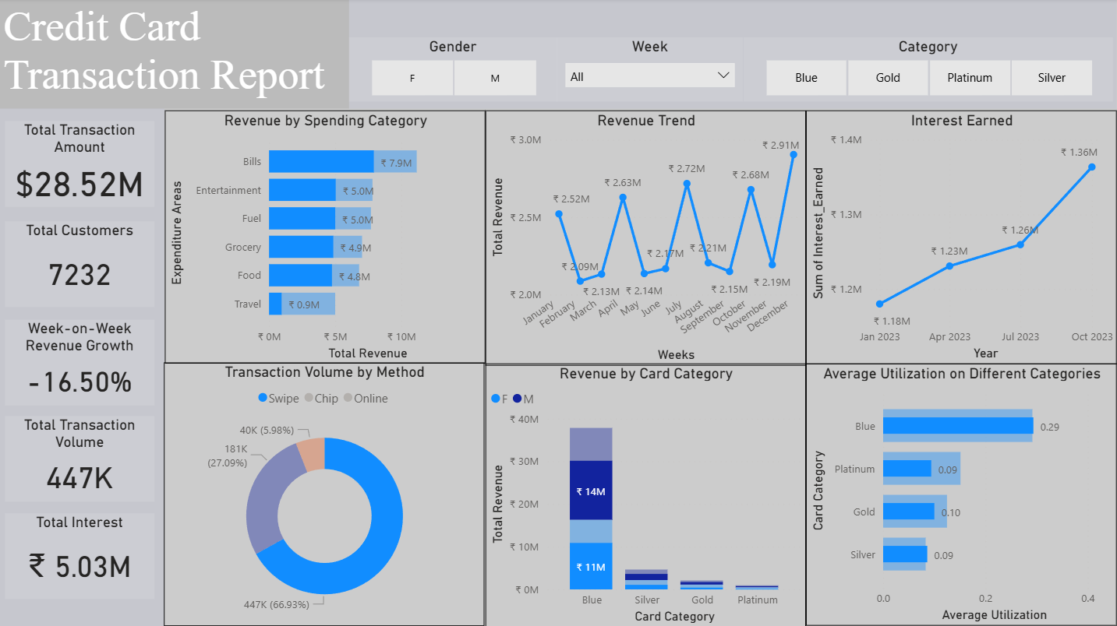
Dashboard 2 Deep-Dive
Focus: Physical "Card-Present" transactions via magnetic stripe or terminal swipe. Highly utilized in retail, grocery, and fuel sectors.
Notes:
Now, let’s look at the physical touchpoint of our business: Swipe Transactions. When we isolate this method, we see a very specific spending profile. This isn't where people book expensive flights or luxury hotels; this is where they buy their groceries, fill up their gas tanks, and pay for their morning coffee. By analyzing this data, we can partner with local retailers for 'point-of-sale' rewards, ensuring that every time a customer reaches for a card to swipe, they choose ours for the immediate cashback benefits.

Slide 13
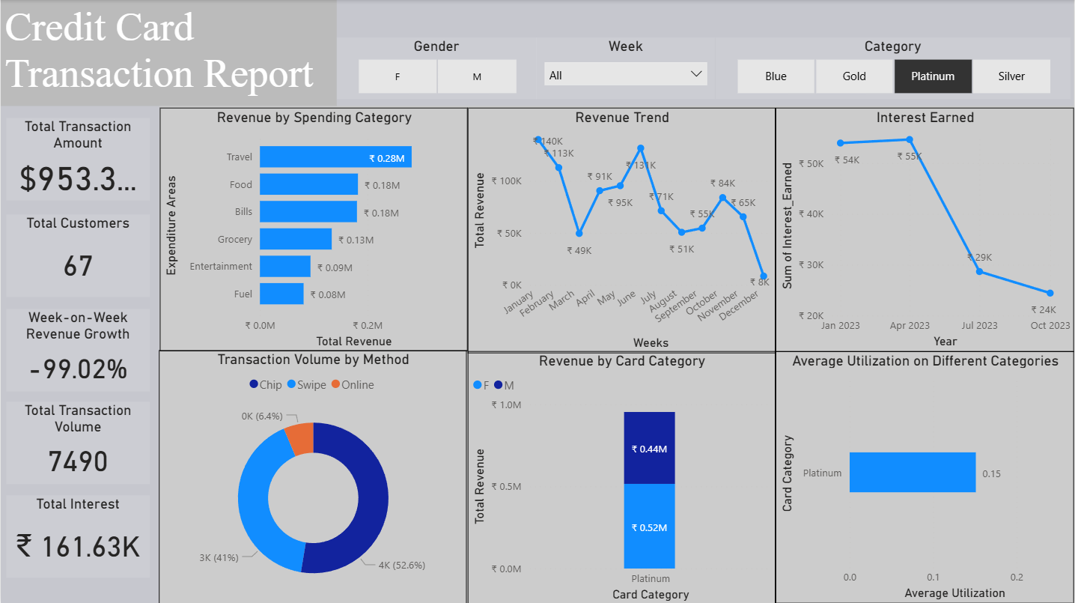
Dashboard 2 Deep-Dive
Focus: Platinum Cardholders during the first 10 weeks of the year. Analysis of top-tier spending behavior during the early Q1 period.
Notes:
By filtering for this early Q1 period, we can see exactly how our most affluent clients start their year. This represents a prime opportunity for targeted 'high-spend' incentives. If we can encourage just a 5% increase in their usage during this early-year window, the revenue impact would be equivalent to hundreds of standard cardholders. It’s about focusing on value over volume.

Slide 14
Strategic Takeaways
Tier Migration: Targeted upgrade campaigns for 'Blue' cardholders—specifically the Single Male segment—to move them into Silver and Gold categories based on high spending velocity.
Portfolio Anchors: Continued focus on the 'Female Graduate' segment as a low-risk, high-retention revenue base.
Utilization Growth: Implementing Q1 incentives for 'Platinum' holders to improve the utilization-to-limit ratio.
Daily Essential Spend: Strengthening merchant partnerships in the 'Fuel' and 'Grocery' sectors to capture the high frequency of physical 'Swipe' transactions.
Notes:
To bring everything together, our analysis reveals a dual-engine growth model. We have a high-volume base in our Blue cardholders who are ready for upward migration, and a high-value base in our Platinum and Graduate segments that require deeper engagement.
By focusing our upcoming strategy on increasing utilization among top-tier clients while transitioning high-velocity spenders to more premium card categories, we can drive significant revenue growth without increasing our customer acquisition costs. These dashboards move us away from reactive reporting and give us the surgical precision needed to make data-driven decisions that impact the bottom line.

Slide 15
Thank You
LinkedIn: https://www.linkedin.com/in/ruchir-a-308240128/
GitHub: https://github.com/ruchira559
Notes:
Thank you.

